Slide 1
Digital Fundamentals
CHAPTER 4 Boolean Algebra and Logic Simplification

Slide 2
Chapter Outline
4–1 Boolean Operations and Expressions
4–2 Laws and Rules of Boolean Algebra
4–3 DeMorgan’s Theorems
4–4 Boolean Analysis of Logic Circuits
4–5 Logic Simplification Using Boolean Algebra
4–6 Standard Forms of Boolean Expressions
4–7 Boolean Expressions and Truth Tables
4–8 The Karnaugh Map
4–9 Karnaugh Map SOP Minimization
4–10 Karnaugh Map POS Minimization
4–11 The Quine-McCluskey Method
4–12 Boolean Expressions with VHDL Applied Logic

Slide 3
Boolean Operations and Expressions

Slide 4
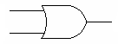
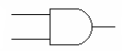
Boolean Operations and Expressions
Addition
0 + 0 = 0
0 + 1 = 1
1 + 0 = 1
1 + 1 = 1
Multiplication
0 * 0 = 0
0 * 1 = 0
1 * 0 = 0
1 * 1 = 1

Slide 5
Checkup
1. If A = 0, what does A equal?
2. Determine the values of A, B, and C that make the sum term A + B + C equal to 0.
3. Determine the values of A, B, and C that make the product term ABC equal to 1.

Slide 6
Laws and Rules of Boolean Algebra

Slide 7
Laws Boolean Algebra
Commutative Laws
Associative Laws
Distributive Law

Slide 8
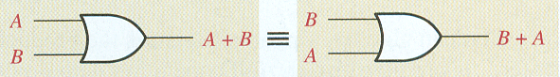
Laws of Boolean Algebra
Commutative Law of Addition:
A + B = B + A

Slide 9
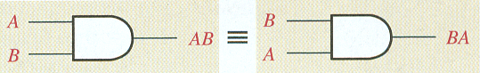
Laws of Boolean Algebra
Commutative Law of Multiplication:
A * B = B * A

Slide 10
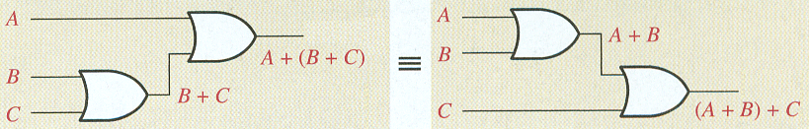
Laws of Boolean Algebra
Associative Law of Addition:
A + (B + C) = (A + B) + C

Slide 11
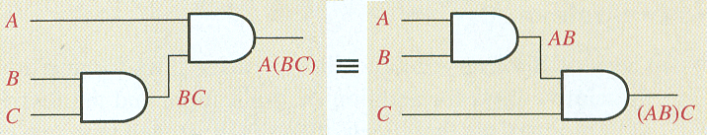
Laws of Boolean Algebra
Associative Law of Multiplication:
A * (B * C) = (A * B) * C

Slide 12
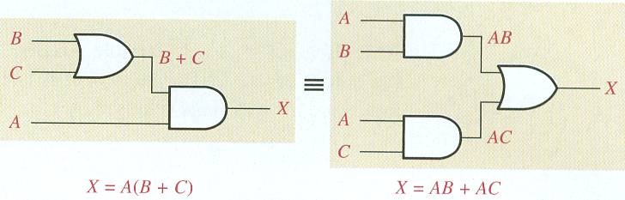
Laws of Boolean Algebra
Distributive Law:
A(B + C) = AB + AC

Slide 13
Checkup
Apply the associative law of addition to the expression
A + (B + C + D).
2. Apply the distributive law to the expression
A(B + C + D).
Solution:
A + (B + C + D) = (A + B + C )+ D
A(B + C + D) = AB + AC + AD)

Slide 14
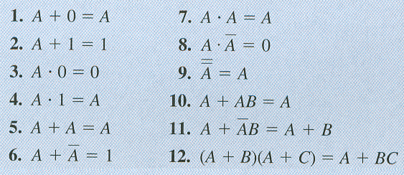
Rules of Boolean Algebra

Slide 15
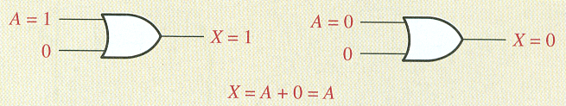
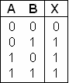
Rules of Boolean Algebra
Rule 1
OR Truth Table

Slide 16
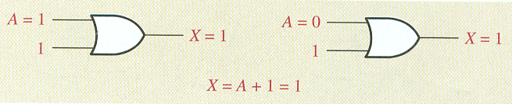
Rules of Boolean Algebra
Rule 2
OR Truth Table

Slide 17
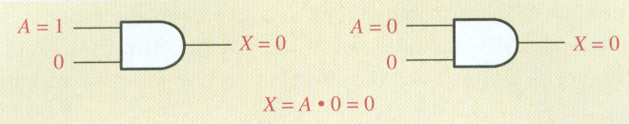
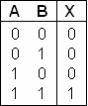
Rules of Boolean Algebra
Rule 3
AND Truth Table

Slide 18
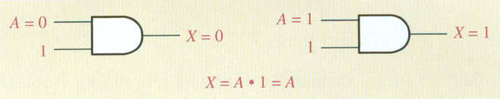
Rules of Boolean Algebra
Rule 4
AND Truth Table

Slide 19
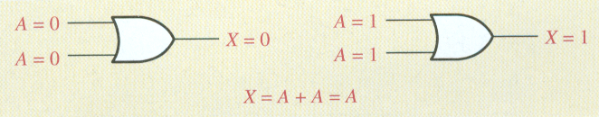
Rules of Boolean Algebra
Rule 5
OR Truth Table

Slide 20
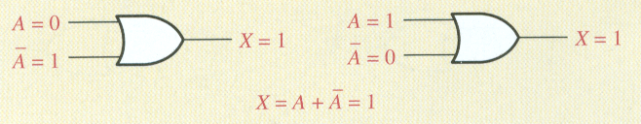
Rules of Boolean Algebra
Rule 6
OR Truth Table

Slide 21
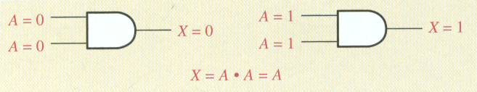
Rules of Boolean Algebra
Rule 7
AND Truth Table

Slide 22
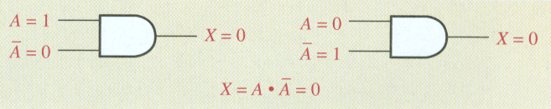
Rules of Boolean Algebra
Rule 8
AND Truth Table

Slide 23
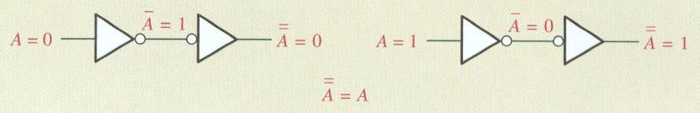
Rules of Boolean Algebra
Rule 9

Slide 24
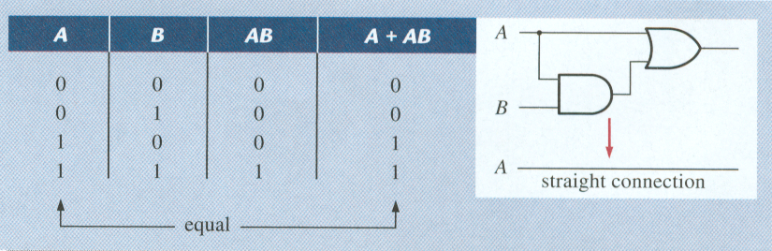
Rules of Boolean Algebra
Rule 10: A + AB = A
AND Truth Table
OR Truth Table

Slide 25
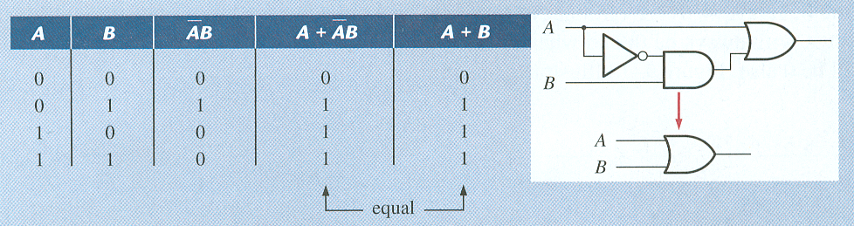
Rules of Boolean Algebra
Rule 11:
AND Truth Table
OR Truth Table

Slide 26
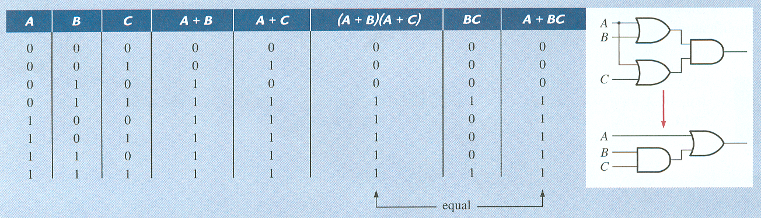
Rules of Boolean Algebra
Rule 12: (A + B)(A + C) = A + BC
AND Truth Table
OR Truth Table

Slide 27
4–3 DeMorgan’s Theorem
State DeMorgan’s theorems
Relate DeMorgan’s theorems to the equivalency of the
NAND and negative-OR gates
NOR and negative-AND gates
Apply DeMorgan’s theorems to the simplification of Boolean expressions
Notes:
In Chapter 3 we have discussed (Slide # 31)
NAND and negative-OR gates
NOR and negative-AND gates
DeMorgan’s theorems provide mathematical verification of the equivalency of the NAND and negative-OR gates and the equivalency of the NOR and negative-AND gates,
After completing this section, you should be able to

Slide 28
DeMorgan’s Theorems
Theorem 1
Theorem 2
Remember:
“Break the bar, change the sign”
Notes:
DeMorgan’s first theorem is stated as follows:
The complement of a product of variables is equal to the sum of the complements of the variables.
Stated another way,
The complement of two or more ANDed variables is equivalent to the OR of the complements of the individual variables.
DeMorgan’s second theorem is stated as follows:
The complement of a sum of variables is equal to the product of the complements of the variables.
Stated another way,
The complement of two or more ORed variables is equivalent to the AND of the complements of the individual variables.

Slide 32
Applying DeMorgan’s Theorems

Slide 33
Applying DeMorgan’s Theorems

Slide 34
Applying DeMorgan’s Theorems

Slide 35
Applying DeMorgan’s Theorems

Slide 36
Applying DeMorgan’s Theorems

Slide 37
Applying DeMorgan’s Theorems

Slide 41
Checkup

Slide 42
4–4 Boolean Analysis of Logic Circuits
Determine the Boolean expression for a combination of gates
Evaluate the logic operation of a circuit from the Boolean expression
Construct a truth table
Notes:
Boolean algebra provides a concise way to express the operation of a logic circuit formed by a combination of logic gates so that the output can be determined for various combinations of input values. After completing this section, you should be able to

Slide 43
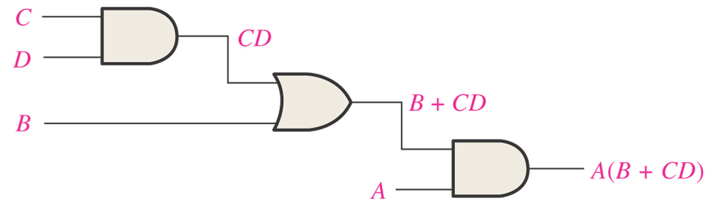
Figure 4–16 A logic circuit showing the development of the Boolean expression for the output.
CD
B + CD
A(B + CD)

Slide 44
Evaluating the Expression
A(B + CD), first find the values of the variables that make the
expression equal to 1, using the rules for Boolean addition and multiplication. In this case, the expression equals 1 only if A = 1 and B + CD = 1 because
A(B + CD) = 1.1 = 1
Now determine when the B + CD term equals 1.
The term B + CD = 1 if either B = 1 or CD = 1 or if both B and CD equal 1 because
B + CD = 1 + 0 = 1
B + CD = 0 + 1 = 1
B + CD = 1 + 1 = 1
The term CD = 1 only if C = 1 and D = 1.
summarize, the expression A(B + CD) = 1 when A = 1 and B = 1 regardless of
the values of C and D or when A = 1 and C = 1 and D = 1 regardless of the value of B.
The expression A(B + CD) = 0 for all other value combinations of the variables

Slide 45
Putting the Results in Truth Table Format
The first step is to list the sixteen input variable combinations of 1s and 0s in a binary sequence as shown in Table 4–5.
Next, place a 1 in the output column for each combination of input variables that was determined in the evaluation.
Finally, place a 0 in the output column for
all other combinations of input variables.

Slide 46
Checkup
1. Replace the AND gates with OR gates and the OR gate with an AND gate in Figure 4–18. Determine the Boolean expression for the output.
2. Construct a truth table for the circuit in Question 1.
Solution:
(C + D)B + A
The expression is a 1 when A is 1 or when B and C are 1s or when B
and D are 1s. The expression is 0 for all other variable combinations.

Slide 47
4–5 Logic Simplification Using Boolean Algebra
A simplified Boolean expression uses the fewest gates possible to implement a given
expression.
Using Boolean algebra techniques, simplify this expression:
AB + A(B + C) + B(B + C)
Solution
The following is not necessarily the only approach.
Step 1: Apply the distributive law to the second and third terms in the expression, as follows:
AB + AB + AC + BB + BC
Step 2: Apply rule 7 (BB = B) to the fourth term.
AB + AB + AC + B + BC
Step 3: Apply rule 5 (AB + AB = AB) to the first two terms.
AB + AC + B + BC
Step 4: Apply rule 10 (B + BC = B) to the last two terms.
AB + AC + B
Step 5: Apply rule 10 (AB + B = B) to the first and third terms.
B + AC

Slide 48
4–5 Logic Simplification Using Boolean Algebra

Slide 49
4–5 Logic Simplification Using Boolean Algebra

Slide 50
4-6 Standard Forms of Boolean Expressions
Identify a sum-of-products expression
Determine the domain of a Boolean expression
Convert any sum-of-products expression to a standard form
Evaluate a standard sum-of-products expression in terms of binary values
Identify a product-of-sums expression
Convert any product-of-sums expression to a standard form
Evaluate a standard product-of-sums expression in terms of binary values
Convert from one standard form to the other

Slide 51
Standard Forms of Boolean Expressions
The sum-of-product (SOP) form
Example: X = AB + CD + EF
The product of sum (POS) form
Example: X = (A + B)(C + D)(E + F)
Notes:
All Boolean expressions, regardless of their form, can be converted into either of two standard forms: the sum-of-products form or the product-of-sums form
Standardization makes the evaluation, simplification, and implementation of Boolean expressions much more systematic
and easier.

Slide 52
The Sum-of-Products (SOP) Form
A product term: a term consisting of the product (Boolean multiplication) of literals (variables or their complements).
When two or more product terms are summed by Boolean addition, the resulting expression is a sum-of-products(SOP).

Slide 53
Domain of a Boolean Expression
The domain of a general Boolean expression is the set of variables contained in the expression in either complemented or un-complemented form. For example,
AB + ABC is the set of variables A, B, C
ABC + CDE + BCD is the set of variables A, B, C, D, E.

Slide 54
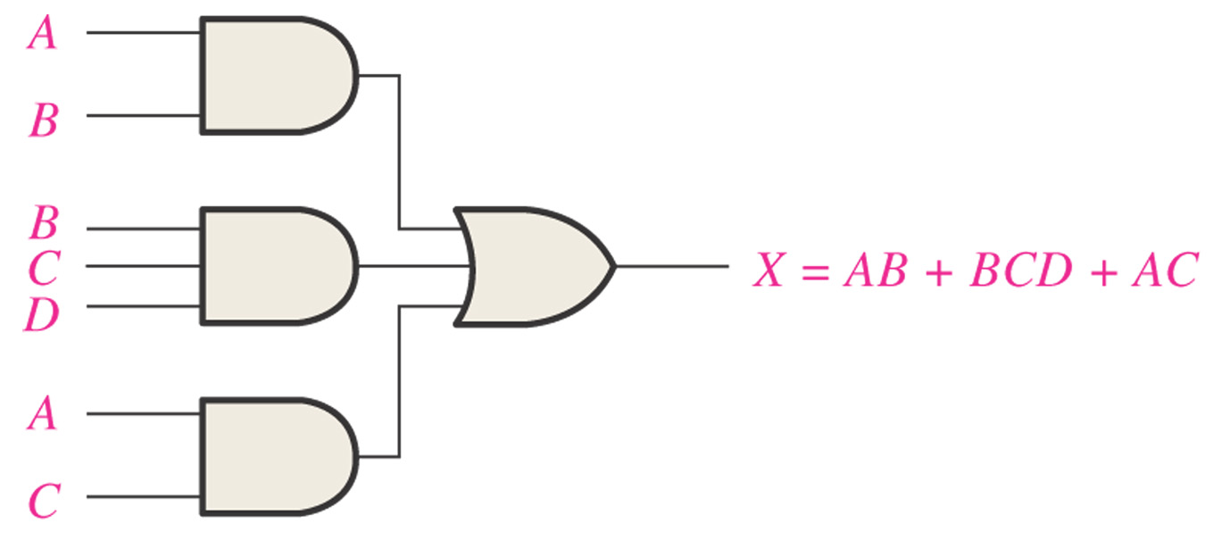
Figure 4–18 Implementation of the SOP expression AB + BCD + AC.

Slide 55
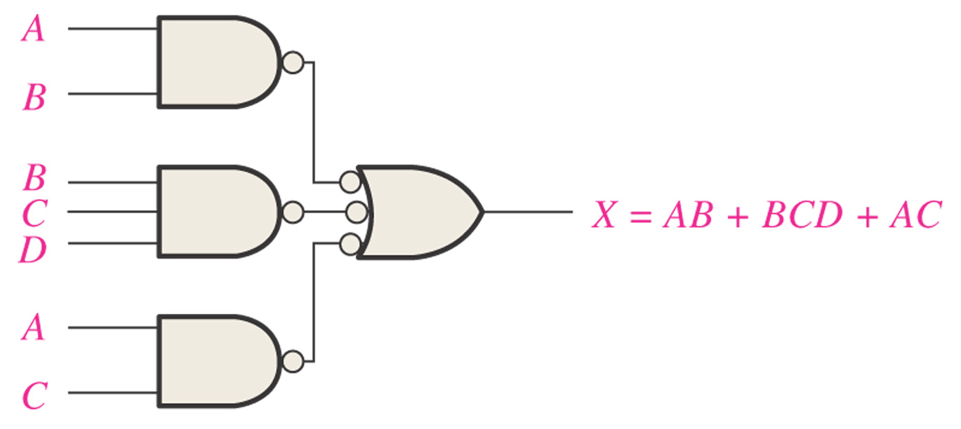
Figure 4–19 This NAND/NAND implementation is equivalent to the AND/OR in Figure 4–18.

Slide 56
Figure 4–19 This NAND/NAND implementation is equivalent to the AND/OR in Figure 4–18.

Slide 57
Conversion of a General Expression to SOP Form
Any logic expression can be changed into SOP form by applying Boolean algebra techniques.
For example,
A(B + CD)
=> AB + ACD //distributive law:

Slide 58
The Karnaugh Map

Slide 59
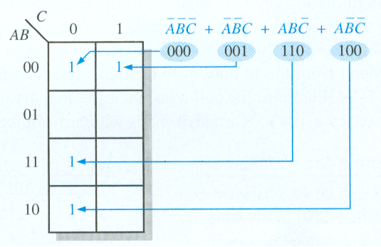
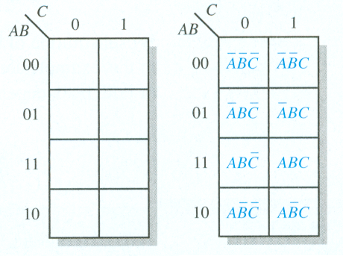
The Karnaugh Map
3-Variable Example
3-Variable Karnaugh Map

Slide 60
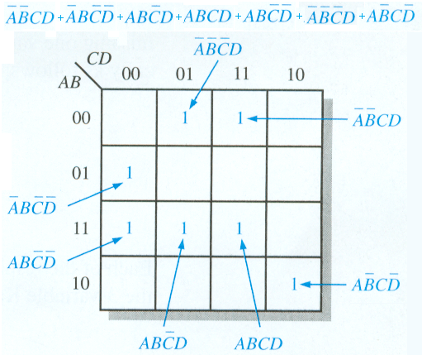
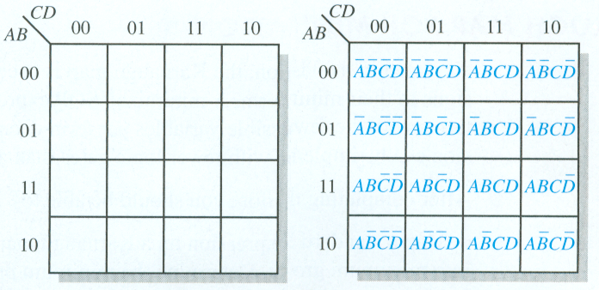
The Karnaugh Map
4-Variable Karnaugh Map
4-Variable Example

Slide 61
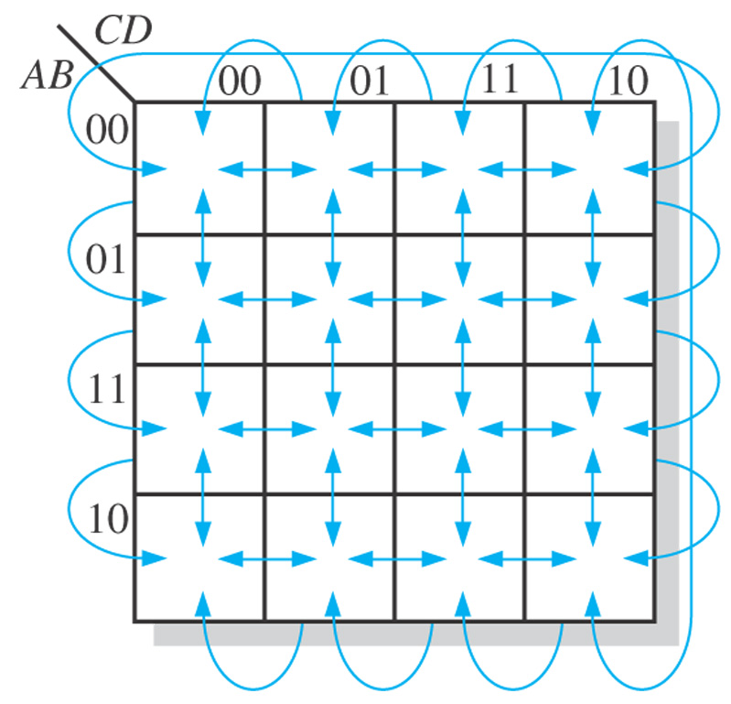
Figure 4–23 Adjacent cells on a Karnaugh map are those that differ by only one variable. Arrows point between adjacent cells.

Slide 62
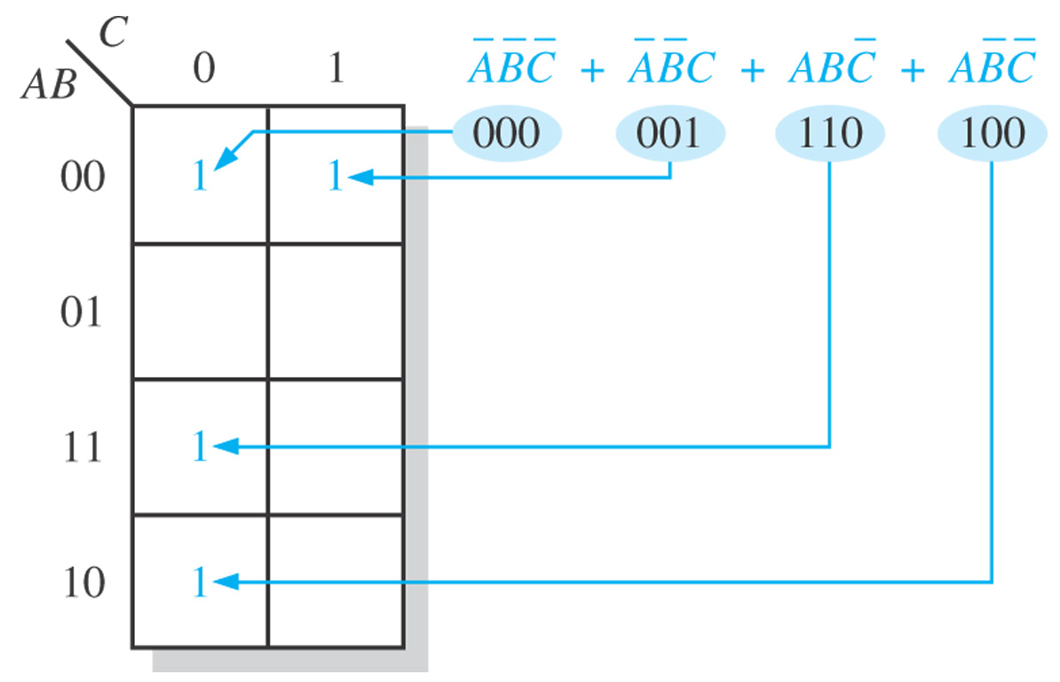
Figure 4–24 Example of mapping a standard SOP expression.

Slide 63
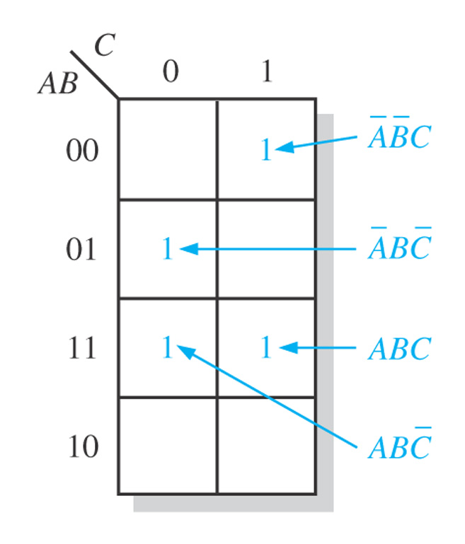
Figure 4–25

Slide 64
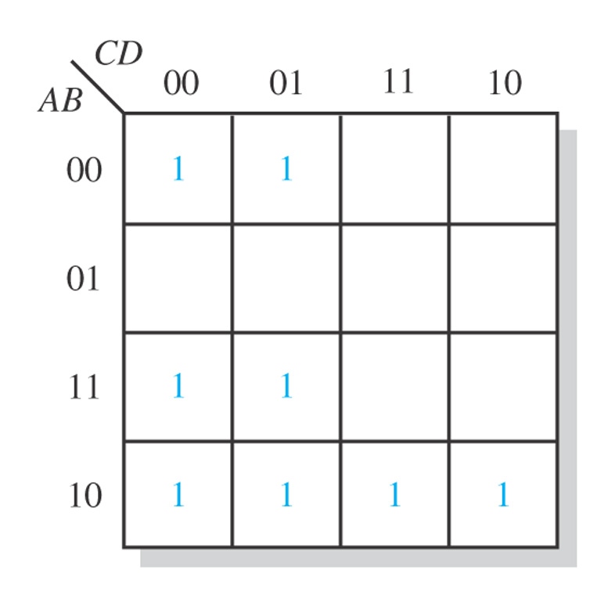
Figure 4–28

Slide 65
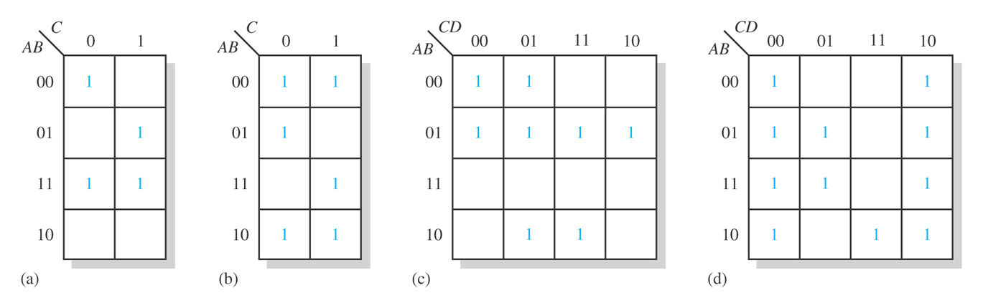
Figure 4–29

Slide 66
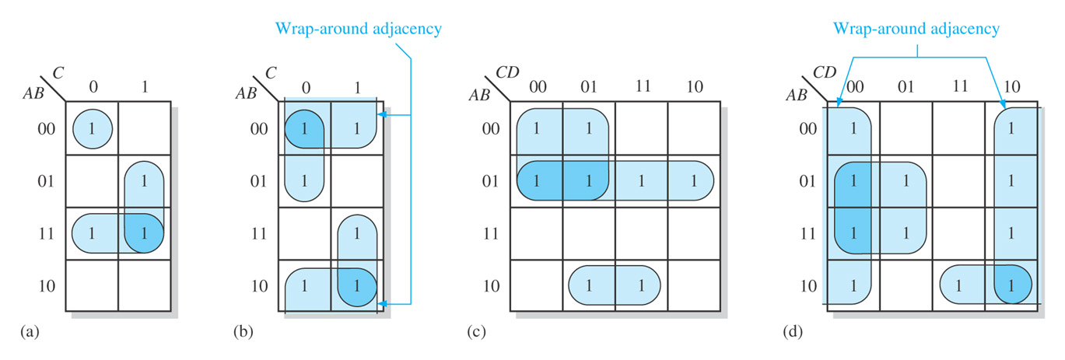
Figure 4–30

Slide 67
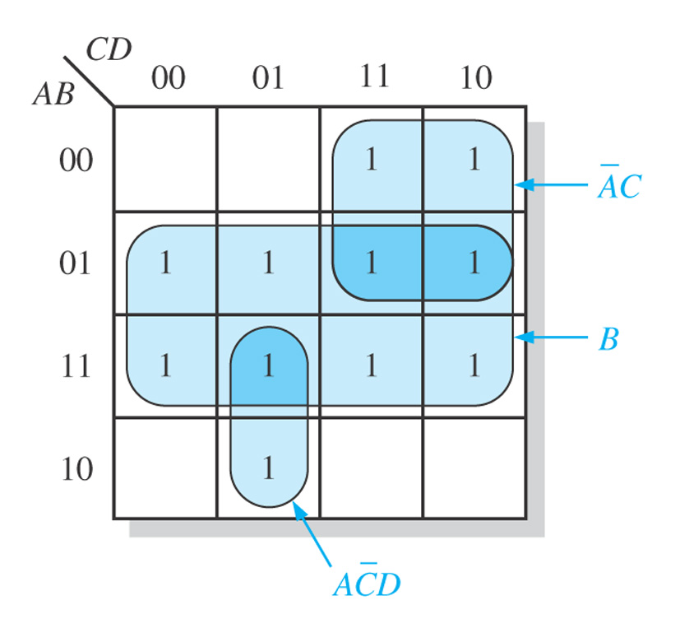
Figure 4–31

Slide 68
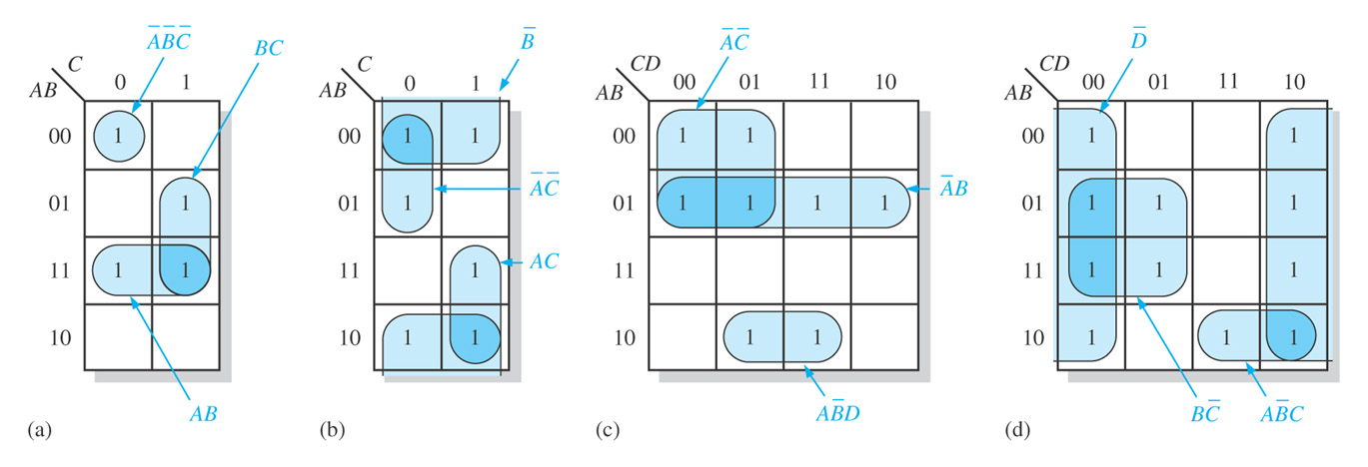
Figure 4–32

Slide 69
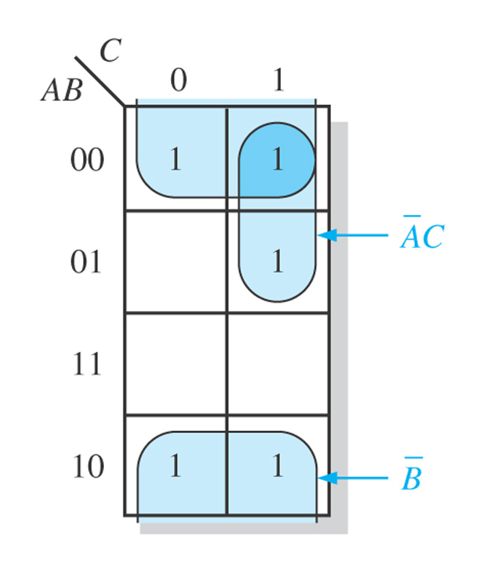
Figure 4–33

Slide 70
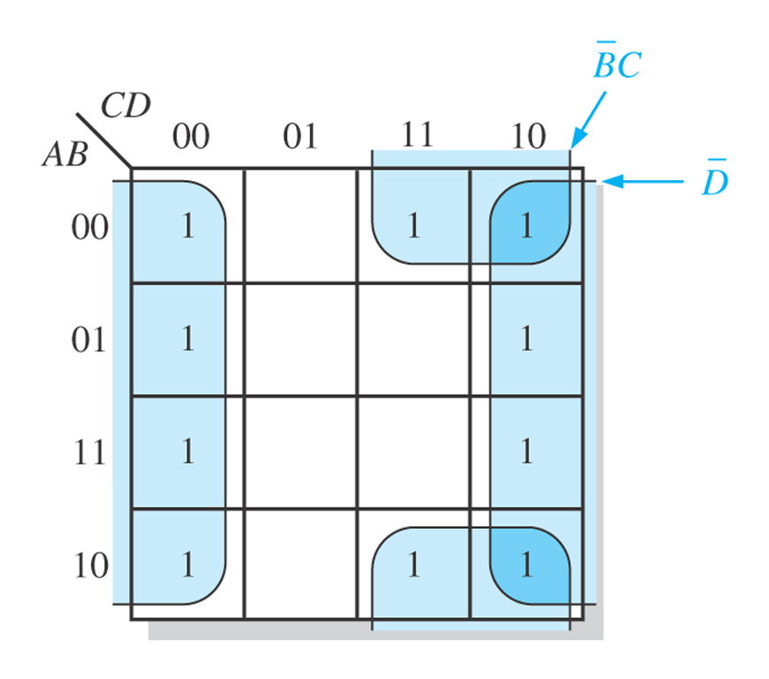
Figure 4–34

Slide 71
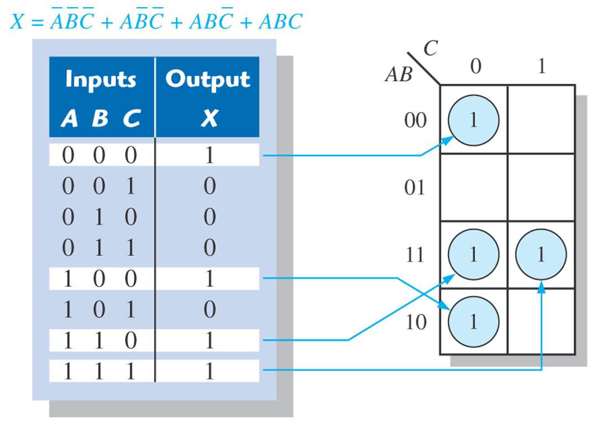
Figure 4–35 Example of mapping directly from a truth table to a Karnaugh map.

Slide 72
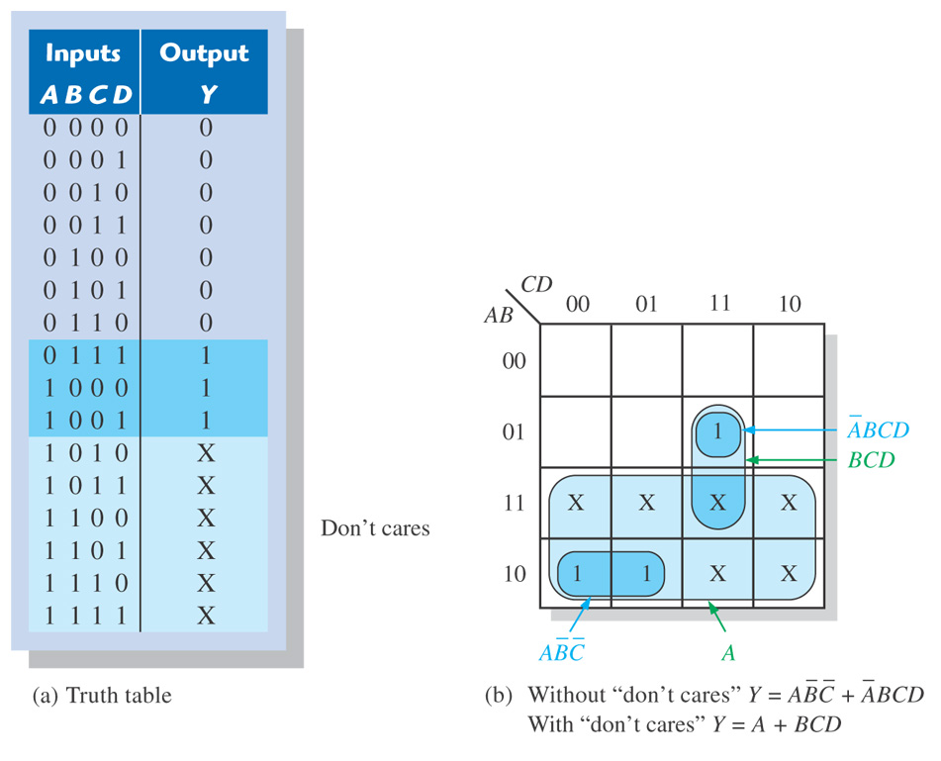
Figure 4–36 Example of the use of “don’t care” conditions to simplify an expression.

Slide 73
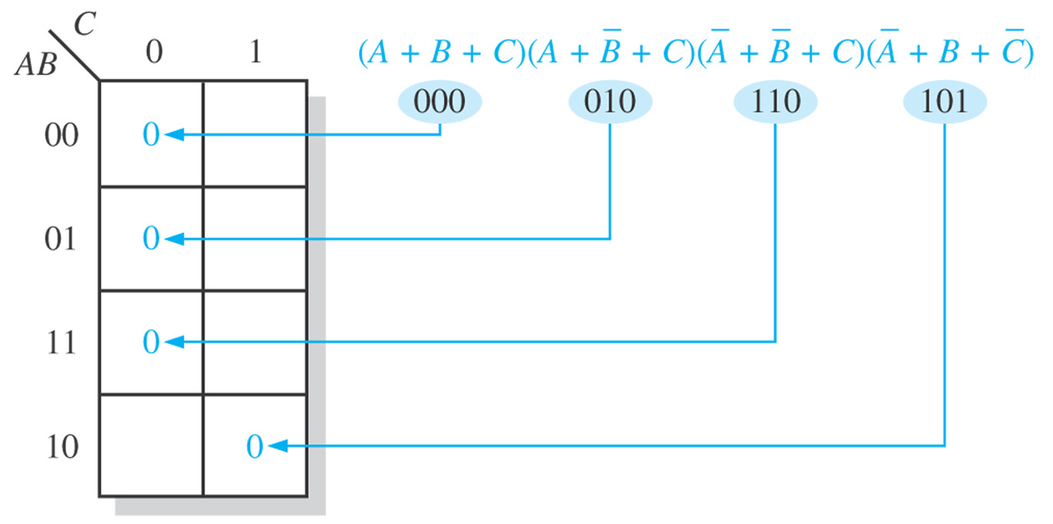
Figure 4–37 Example of mapping a standard POS expression.

Slide 74
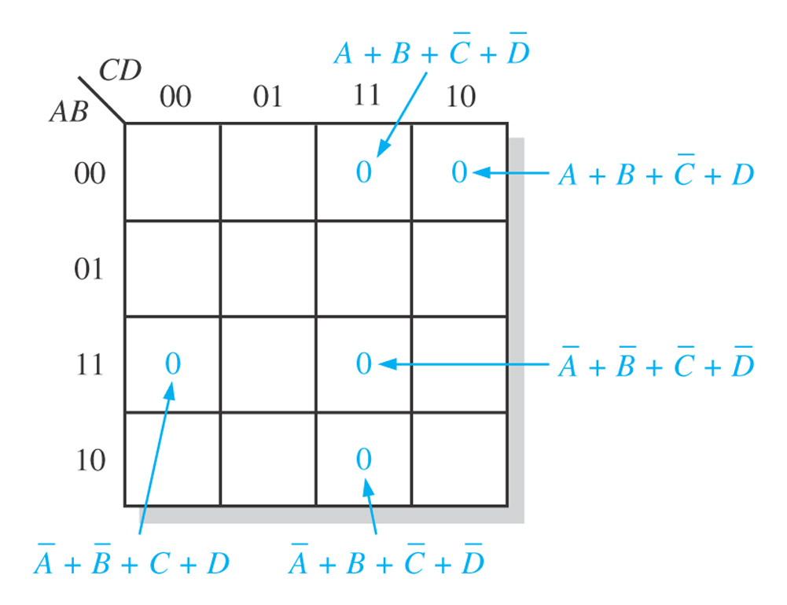
Figure 4–38

Slide 75
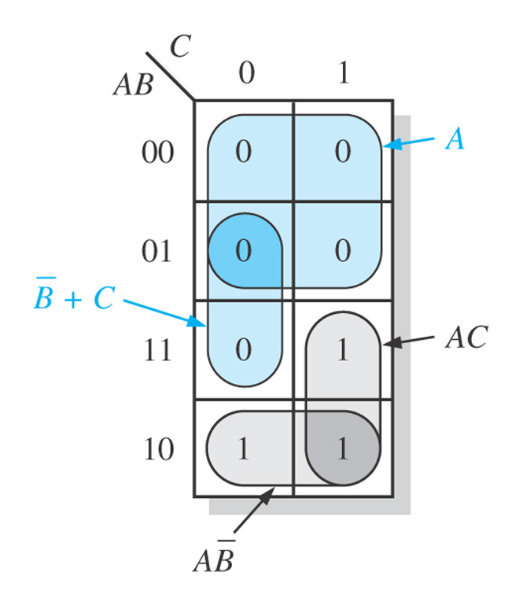
Figure 4–39

Slide 76
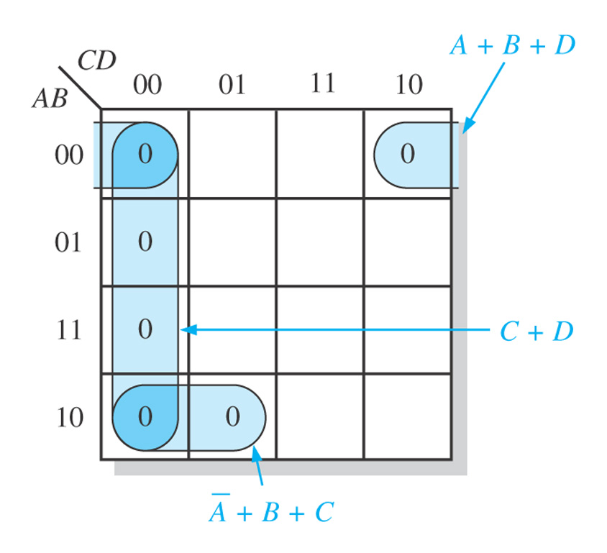
Figure 4–40

Slide 77
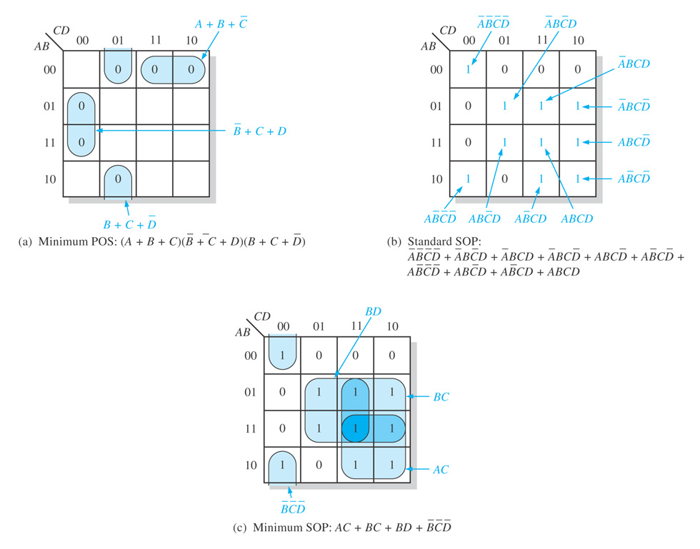
Figure 4–41

Slide 78
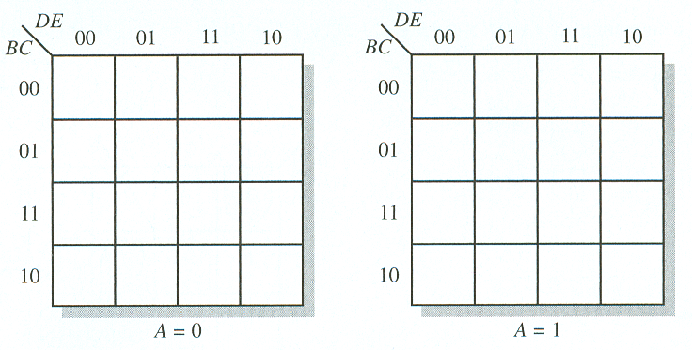
The Karnaugh Map
5-Variable Karnaugh Mapping

Slide 79
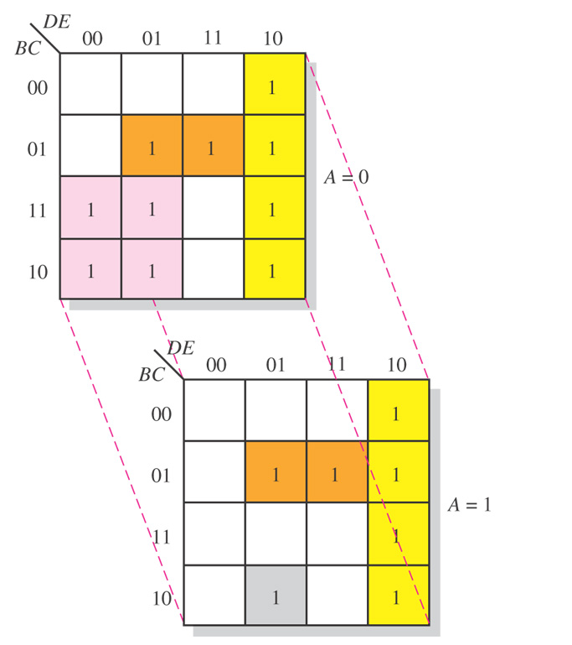
Figure 4–43 Illustration of groupings of 1s in adjacent cells of a 5-variable map.

Slide 80
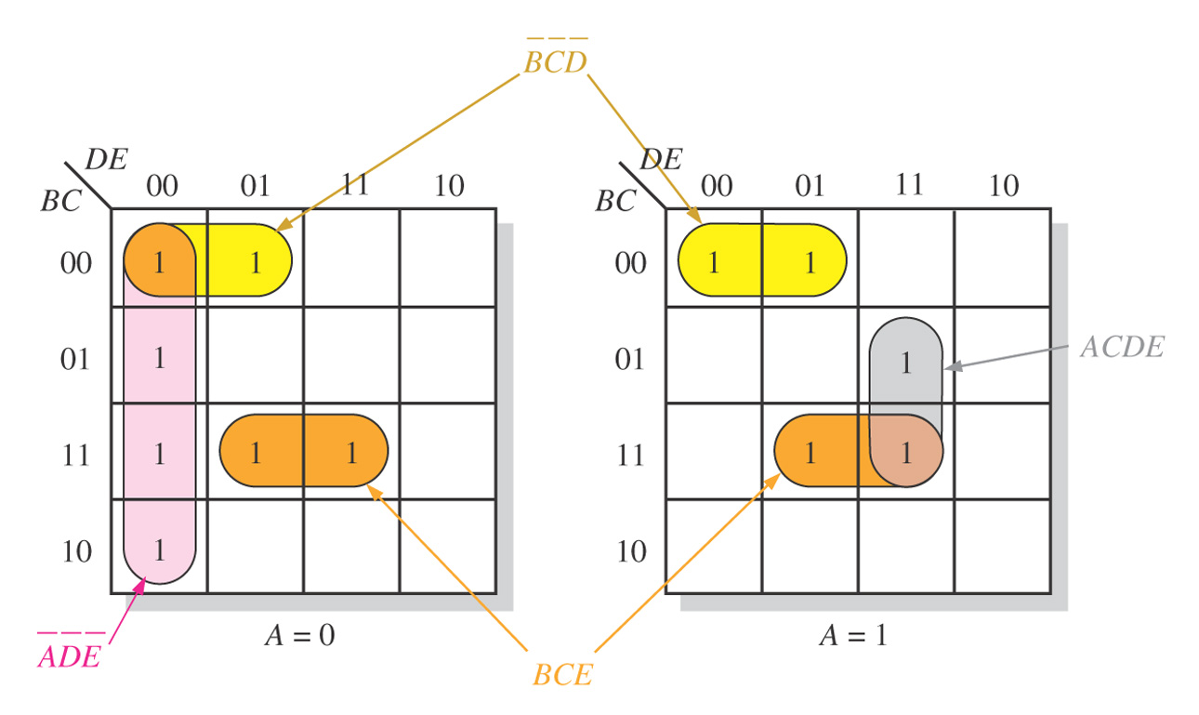
Figure 4–44

Slide 81
VHDL

Slide 82
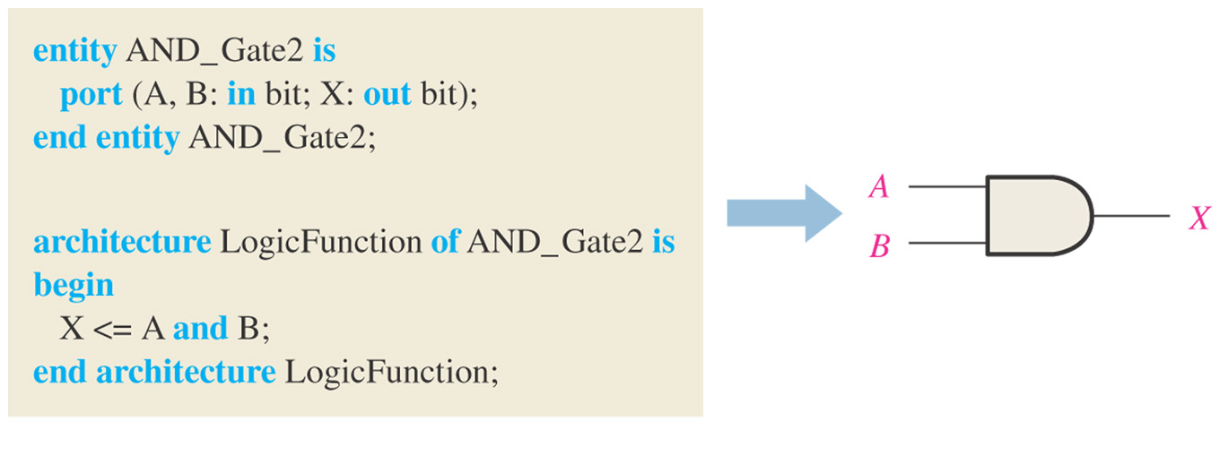
Figure 4–45 A VHDL program for a 2-input AND gate.

Slide 83
VHDL
VHDL Operators
and
or
not
nand
nor
xor
xnor
VHDL Elements
entity
architecture

Slide 84
VHDL
Entity Structure
Example:
entity AND_Gate1 is
port(A,B:in bit:X:out bit);
end entity AND_Gate1

Slide 85
VHDL
Architecture
Example:
architecture LogicFunction of AND_Gate1 is
begin
X<=A and B;
end architecture LogicFunction

Slide 86

Figure 4–46

Slide 87
Hardware Description Languages (HDL)
Boolean Expressions in VHDL
AND X <= A and B;
OR X <= A or B;
NOT X <= A not B;
NAND X <= A nand B;
NOR X <= A nor B;
XOR X <= A xor B;
XNOR X <= A xnor B;

Slide 88

Figure 4–47 Seven-segment display format showing arrangement of segments.

Slide 89

Figure 4–48 Display of decimal digits with a 7-segment device.

Slide 90

Figure 4–49 Arrangements of 7-segment LED displays.

Slide 91

Figure 4–50 Block diagram of 7-segment logic and display.

Slide 92

Figure 4–51 Karnaugh map minimization of the segment-a logic expression.

Slide 93

Figure 4–52 The minimum logic implementation for segment a of the 7-segment display.

Slide 94

Summary

Slide 95

Figure 4–54

Slide 96

Figure 4–55. What is the Boolean expression for each of the logic gates?

Slide 97

Figure 4–56. What is the Boolean expression for each of the logic gates?

Slide 98

Figure 4–58. Derive a standard SOP and standard POS expression for each truth table.

Slide 99

Figure 4–59. Reduce the function in the truth table to its minimum SOP form by using a Karnaugh map.

Slide 100

Figure 4–62. Example 4-21. Related Problem answer.

Slide 101

Figure 4–63. Example 4-22. Related Problem answer.

Slide 102

Figure 4–64. Example 4-23. Related Problem answer.

Slide 103

Figure 4–65. Example 4-24. Related Problem answer.

Slide 104

Figure 4–66. Example 4-30. Related Problem answer.

